Slide 1

IMDB Movies characteristics
Data Science – Final Project

Slide 2

Project Members:
Member A:
Name: Elad Cohen
ID: 208931394
Email: elad96c@gmail.com
Member B:
Name: Avi Barhom
ID: 203572748
Email: avibarhom1111@gmail.com

Slide 3
Contents:
Use this contents table as reference for a specific chapter:
Slide | Topic
4 | Abstract
5 | Background
6 | Introduction
7 – 11 | Data Acquisition
12 – 23 | Data Cleaning
24 – 36 | Exploratory data analysis
37 – 45 | Predicative & Learning Experiments
46 - 47 | Conclusion

Slide 4
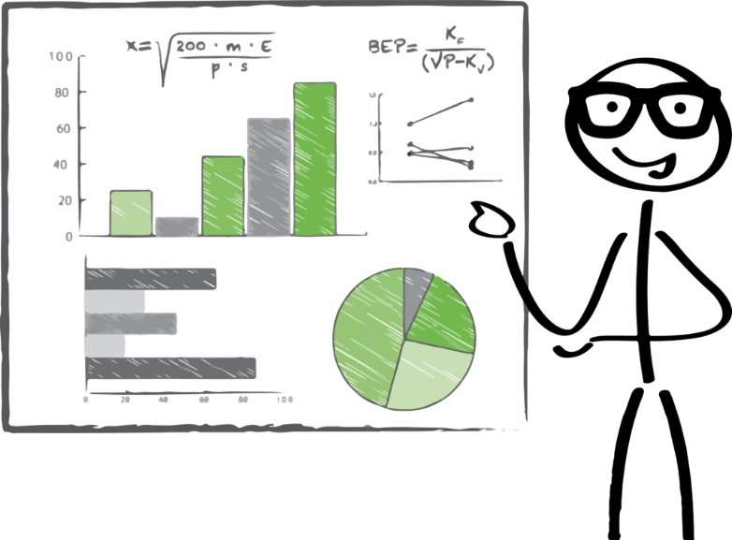
Abstract
In this project, we will analyze the data of IMDB (The Internet Movie Database) -
Website which provides information related to Movies, TV-shows, and Video games. In our research we will focus at the information related to Films (Worldwide) .
Due to the amount of data gathered over the years, we are hoping to find significant insights related to movies.
Our main research goal is:
“ What are the most important attributes to predict gross income? ”
In addition, we found those topics interesting as well:
“Which year was the best for movie production?”
“Do user ratings similar to critics ratings?”
“How long should a successful movie be?”
“Which genres people rate higher?”

Slide 5
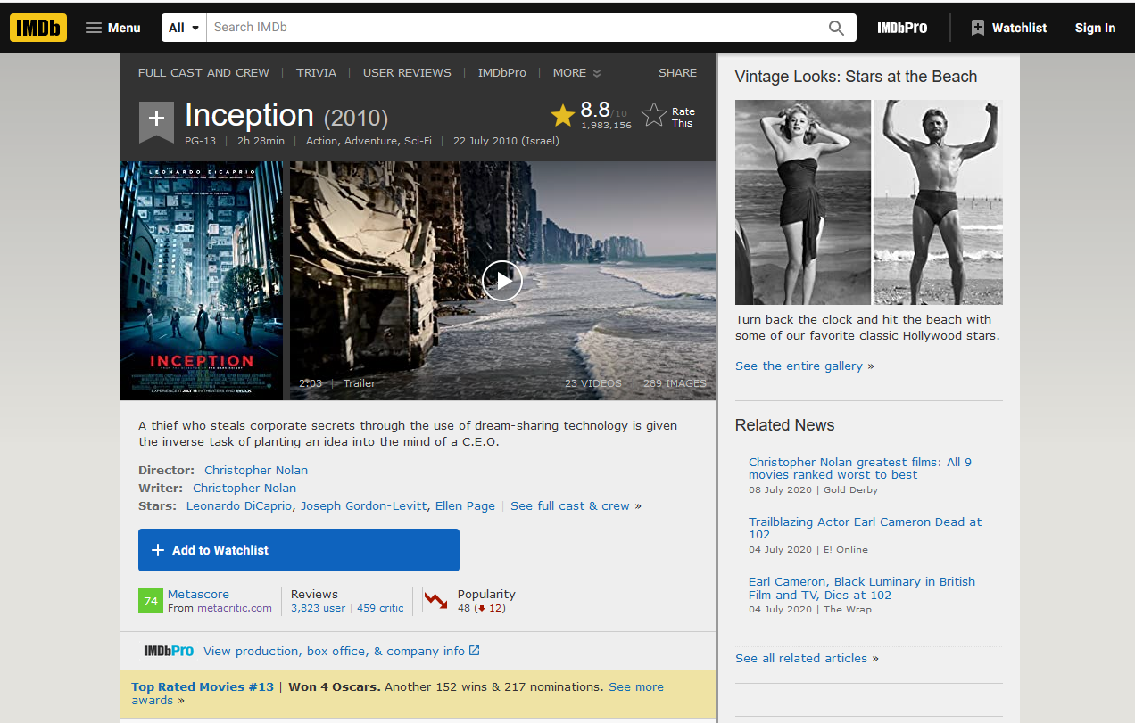
Background
IMDB is an online database of information related to films, tv-shows, videogames, etc.
As of January 2020, it has approximately 6.5 million titles (including episodes) and 10.4 million personalities in its database, as well as 83 million registered users.
The website contains formal data of movies, as well as user reviews and critics reviews.
Unfortunately, the website doesn’t include support for an API, therefore the data has to be scrapped.

Slide 6
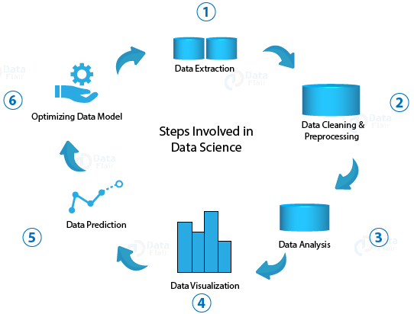
Introduction
In our project we will gather, process and evaluate IMDB’s data.
We chose to simplify the process into 3 main objectives:
1. Data Acquisition: By our research goals, we had to scrap 2 types of data (Beautiful Soup): A. IMDB’s top 250 movies of all time. B. IMDB’s most rated movies (1990 – 2020).
2. Data Cleaning: The raw data is not “Evaluation ready”, therefore it has to be cleaned: A. Rearrange format (ex: Movie duration from “1hr 30m” into “90” (minutes)). B. Track outliers (ex: Movie with 1,000,000,000$ budget (irrational)). C. Fill/Remove missing data (NaN cells).
3. Data Evaluation: After the previous stages, we get data that is ready to be evaluated: A. Different plots for a visual representation of the data. B. Correlation matrix which indicates the weights of the data fields. C. SKLearn Machine learning for “attributes prediction” accuracy analyzing.

Slide 7
Data Acquisition - Overview
The data we need for this project is found at the IMDB website.
Among the data in the website we can find for each movie: Film title, budget, gross income, release year, genre, ratings, critics, movie length, movie summary, actors, directors, and more…
In particular, The films we would gather information about are:
Movies with many ratings (1990 – Present) & Movies with high rating (Top 250) – Those can be filtered using IMDB search which allows sorting the most voted movies first (for each year).
Unfortunately, IMDB doesn’t support an official API.
Therefore, we will use Python with the BeautifulSoup Library to scrap information from the website.
To scrap IMDB, we will make a list of relevant movie pages, and then identify the related tags in the HTML code for the info we wish to extract.

Slide 8
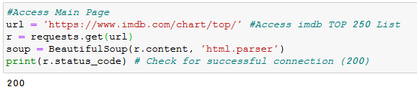
Data Acquisition – The code (1/4)
The Jupiter notebooks relevant for this part are:
Data Acquisition - 250.ipynb (export: IMDB_250_Dataset.csv) // Top 250 Data
Data Acquisition - Many.ipynb (export: IMDB_ManyRatings_Dataset.csv) // 1990 – 2020 Movies (50 most rated of each year) Data
Stage 1: Check accessibility for IMDB Beautiful soup scraping.
We received status code of “200” which indicates the connection has succeeded.

Slide 9
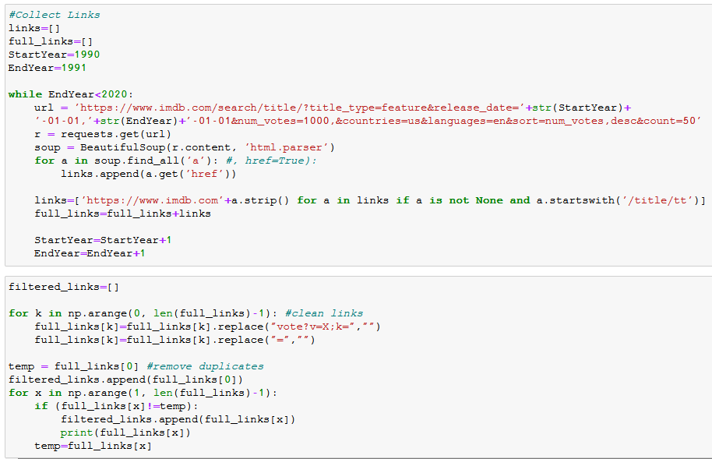
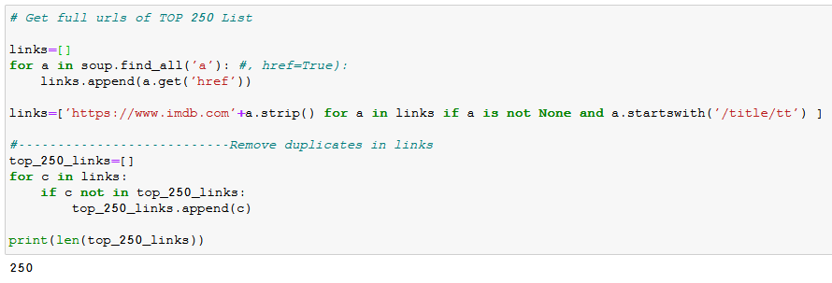
Data Acquisition – The code (2/4)
Stage 2: Collect links for the relevant movies:
250 Top rated of all time links will be collected from https://www.imdb.com/chart/top?ref_=nv_mv_250
50 Most rated of each year (1990 – 2020) will be collected from https://www.imdb.com/search/title/?title_type=feature&release_date=1990-01-01,2020-01-01&num_votes=1000,&countries=us&languages=en&sort=num_votes,desc&count=50
(B)
(A)

Slide 10
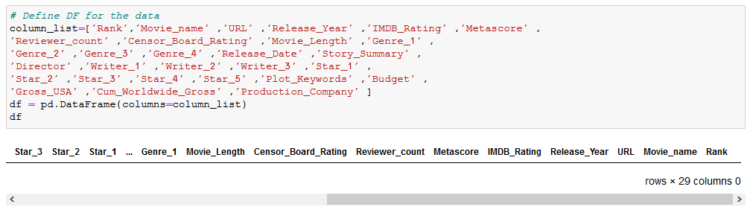
Data Acquisition – The code (3/4)
Stage 3: Define the dataframe and its columns.
Stage 4: Scrap using Python’s Beautiful Soup library (HTML tag selection) – The code for this part can be seen inside the Jupiter notebook.

Slide 11
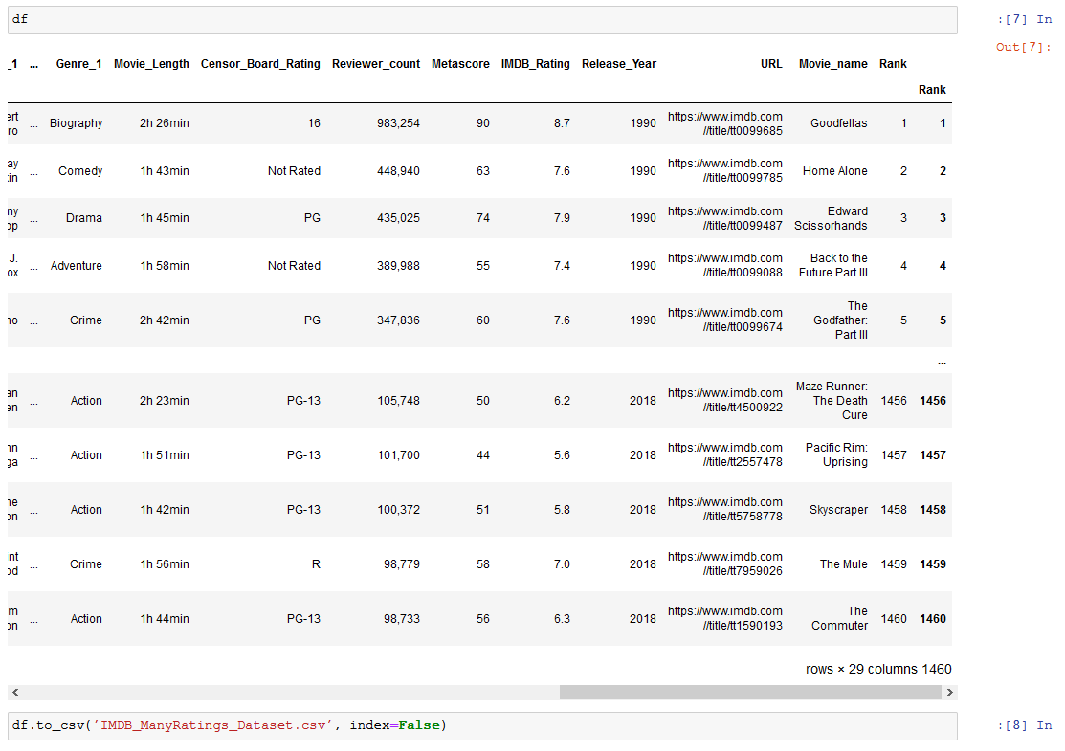
Data Acquisition – The code (4/4)
Stage 5: Data review and CSV Export
As we can see, the initial data looks good and can be transferred to the next phase (Data cleaning) using csv export.

Slide 12

Data cleaning - Overview
The Jupiter notebooks relevant for this part are:
Data Cleaning-250.ipynb (import: IMDB_250_Dataset.csv export: 250_Dataset_Cleaned.csv) // Top 250 Data Cleaned
Data Cleaning-Many.ipynb (import: IMDB_ManyRatings_Dataset.csv export: ManyRatings_Dataset_Cleaned.csv) // 1990 – 2020 Movies (50 most rated of each year) Data Cleaned
Now that we have the data as presented on IMDB’s website, We need process it in a way it will be available for analysis.
In order to keep the presentation clear and simple, We will examine the cleaning process using the following format: For each Column in the dataframe which needs to be cleaned, We will present:
- Column Name & Description
- Bad data example / Why cleaning is required
- The Code Block
- Expected result

Slide 13
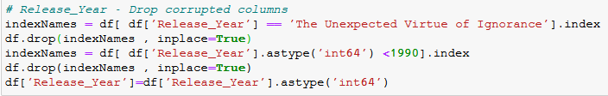
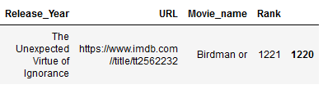
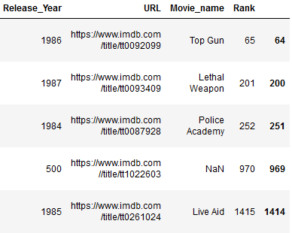
Data cleaning – The code (1/5)
- Column Name & Description: Release_Year
- Bad data example / Why cleaning is required:
Movies should be between 1990 - 2020
- The Code Block:
- Expected result:
We chose to drop the irrelevant rows.

Slide 14

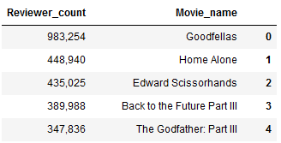


Data cleaning – The code (2/5)
- Column Name & Description: Metascore (Critic Score)
- Bad data example / Why cleaning is required:
For some movies Metascore is unavailable.
- Column Name & Description: Reviewer_count
- Bad data example / Why cleaning is required:
Data stored as Object (Not numeric)
- The Code Block:
- Expected result:
Fill irrelevant rows with NaN
- The Code Block:
- Expected result:
Values as numeric

Slide 15
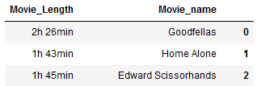
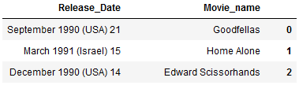
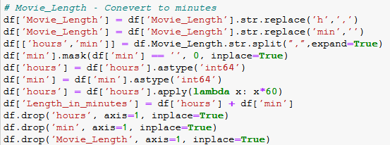

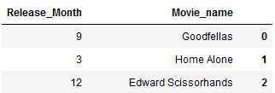
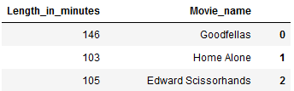
Data cleaning – The code (3/5)
- Column Name & Description: Movie_Length
- Bad data example / Why cleaning is required:
Length represented as String
- Column Name & Description: Release_Date
- Bad data example / Why cleaning is required:
We don’t need the country’s name and the year –
as country is already filtered to be U.S and the year
is already available as “Release_Year”.
- The Code Block:
- Expected result:
New column:
“Length_in_minutes”
- The Code Block:
- Expected result:
New column:
“Release_Month”

Slide 16
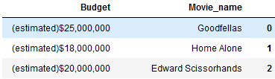
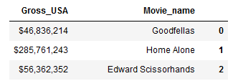


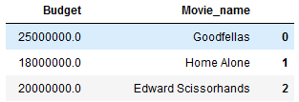
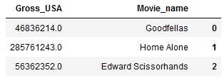
Data cleaning – The code (4/5)
- Column Name & Description: Budget
- Bad data example / Why cleaning is required:
Budget represented as String
- Column Name & Description: Gross_USA (Profit in USA)
- Bad data example / Why cleaning is required:
Gross_USA represented as String
- The Code Block:
- Expected result:
- The Code Block:
- Expected result:

Slide 17
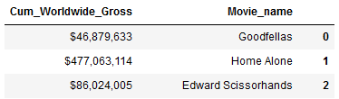


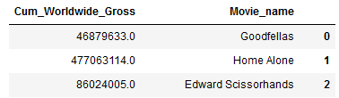
Data cleaning – The code (5/5)
- Column Name & Description: Cum_Worldwide_Gross
- Bad data example / Why cleaning is required:
Budget represented as String
Another cleaning process –
Is the duplication cleaning.
We only want to remove duplications and not just movies with the same name.
This can be achieved by filtering using “Movie_name” AND “Release_Year”
- The Code Block:
- Expected result:

Slide 18
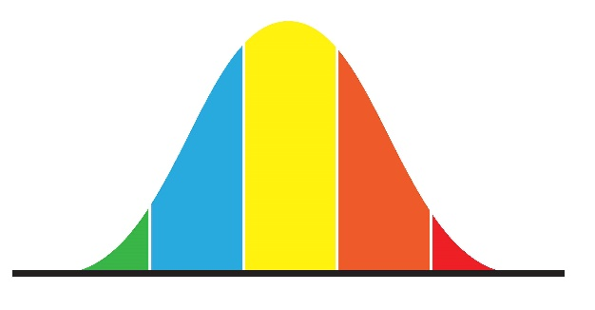
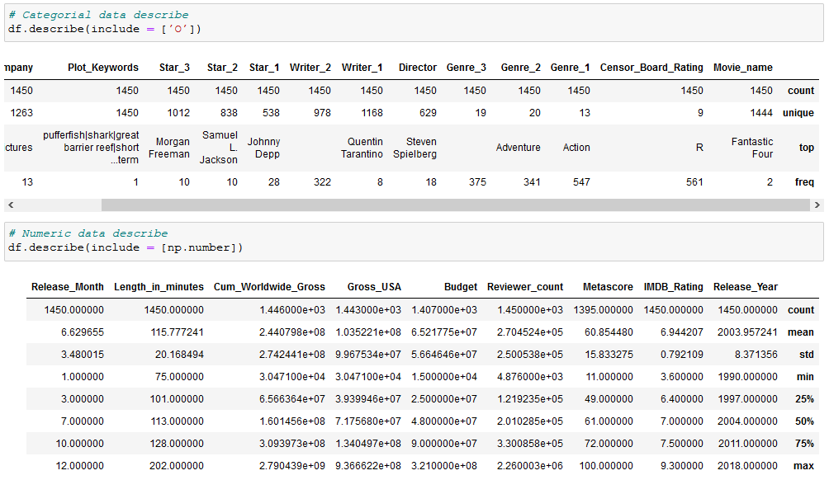
Data cleaning – Outliers (1/5)
The previous steps of the data cleaning have caused each column to be formatted to its correct dtype (String object, int64, float64 …)
Now we can get the right description for both categorial data (top) and numeric data (bottom).
Our next (and final) goal of the data cleaning will be: Outliers detection and treatment.
The process was the same for both of the datasets we acquired.

Slide 19
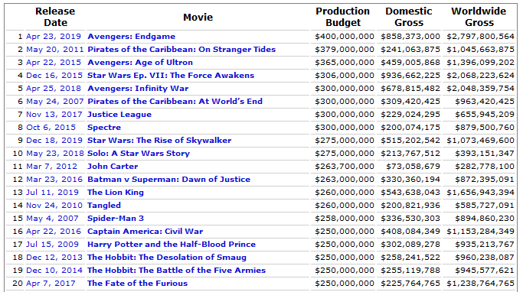
Data cleaning – Outliers (2/5)
When it comes to the Movie Industry,
The production budget and gross are much varied.
In order to evaluate whether the results we received are accurate, we had to compare them to the highest budget films ever created.
As we can see:
- Production Budget < 4e+8 $
- USA Gross < 9e+8 $
- Worldwide Gross < 2.8e+9 $
As for a minimum cap for movie budget we chose to set it as: 1e+6 $(Which counts as very low budget film)

Slide 20
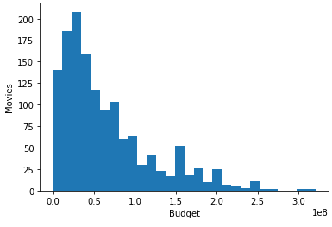
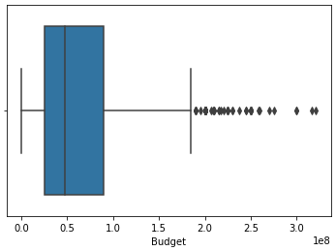
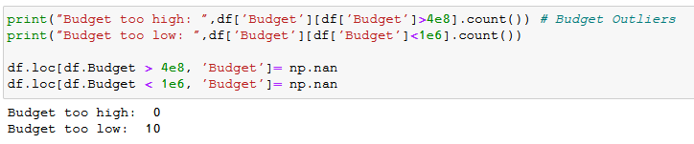
Data cleaning – Outliers (3/5)
Examination of the Budget column against the budget threshold would only cause movies reduction due to budget being too low. (outliers)

Slide 21
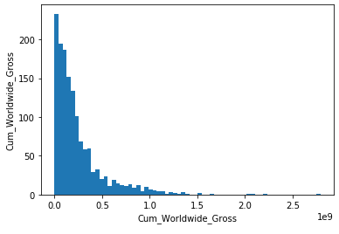
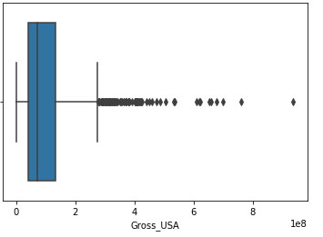
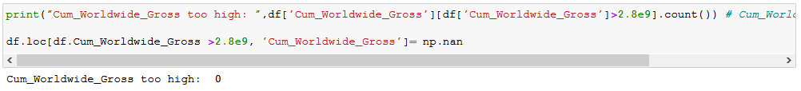
Data cleaning – Outliers (4/5)
Examination of the Worldwide gross column against the Worldwide gross threshold would not cause any movies to be seen as outliers.

Slide 22
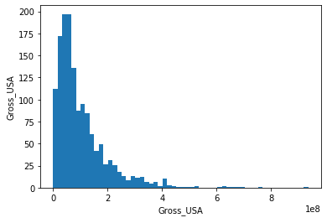
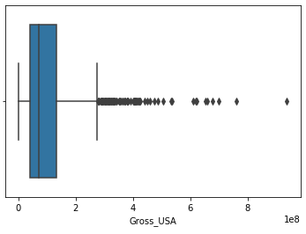

Data cleaning – Outliers (5/5)
Examination of the USA gross column against the USA gross threshold would cause only to one movie to be seen as outlier.

Slide 23

Data cleaning – Final Result
After completing the whole cleaning process, the result we achieved:
File: ManyRatings_Dataset_Cleaned.csv
Contains: 1354 Many rated movies (1990-2020)
Categorial Columns:
Movie Name, Censor Board Rating, Genres, Director, Writers, Stars, Plot Keywords, Production Company.
Numeric Columns:
Release Year, IMDB Rating, Metascore (Critics Rating), Reviewer count, Budget, Gross USA, Gross Worldwide, Length (Minutes), Release Month
File: 250_Dataset_Cleaned.csv
Contains: 174 Top IMDB Movies
Categorial Columns:
Movie Name, Censor Board Rating, Genres, Director, Writers, Stars, Plot Keywords, Production Company.
Numeric Columns:
Release Year, IMDB Rating, Metascore (Critics Rating), Reviewer count, Budget, Gross USA, Gross Worldwide, Length (Minutes), Release Month
Note: The reason we received less movies is mainly because the top 250 movies list contains very old movies which lack of important information.

Slide 24

Exploratory data analysis - Overview
The following slides focuses on different plots and graphs.
Each plot will give us visual representation of the data, and will be used to achieve useful insights.
To recall, Our main research goal is:
“ What are the most important attributes to predict gross income? ”
In addition, we found those topics interesting as well:
“Which year was the best for movie production?”
“Do user rating similar to critics ratings?”
“How long should a successful movie be?”
“Which genres people rate higher?”

Slide 25

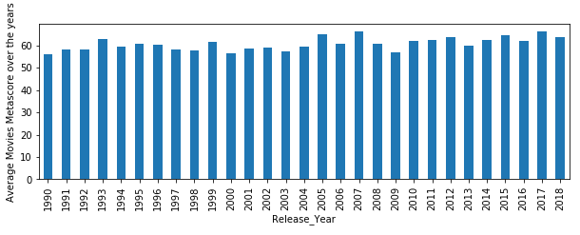
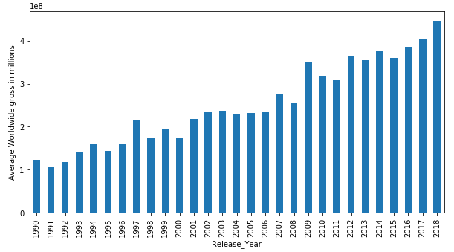
Exploratory data analysis
Q1: “Which year was the best for movie production?”
In order to answer this question, first we need to define the meaning of “best for movie production”.
As we see it, there are 2 measuring aspects for movie production: Rating aspect and Economic aspect.
Rating: The rating (Metascore) average has a constant value of 60 for the past 30 years of our data, therefore it won’t be useful in our question determination.
Economic: The worldwide gross gives us a linear rising graph. Which may indicate the movie’s industry constant growth.

Slide 26
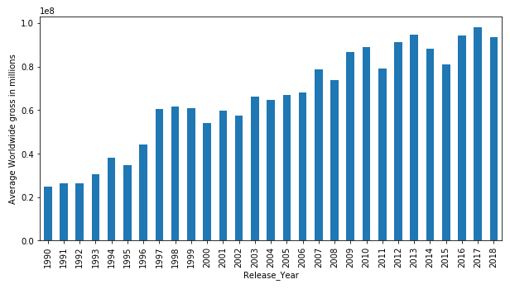
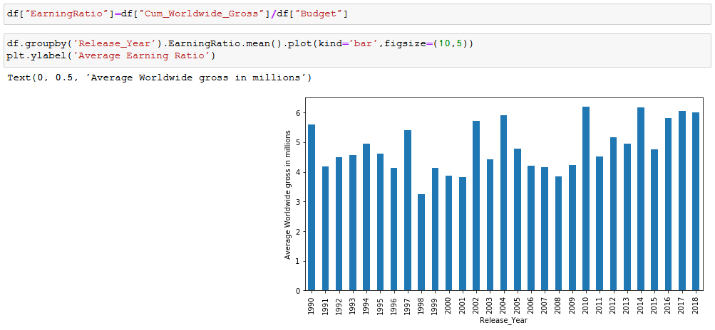
Exploratory data analysis
Q1: “Which year was the best for movie production?”
Examination of the budget graph will show us that not only the worldwide gross has increased over the years, but also the budget. Therefore we will plot a new graph using:
EarningRatio = Worldwide_Gross / Budget
The new plot gives us a much more clear answer:
The average profit ratio was the highest (6) at 2010.
Also, we can say the worst year for movie production was 1998 with only half of the average profit ratio (3)

Slide 27
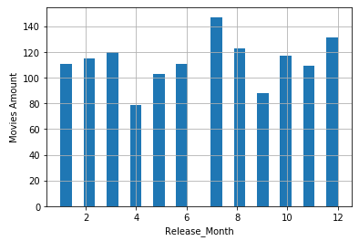
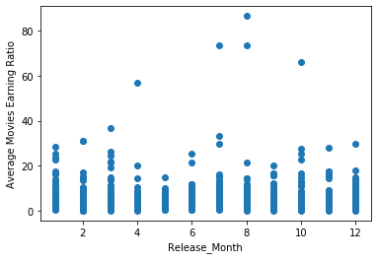
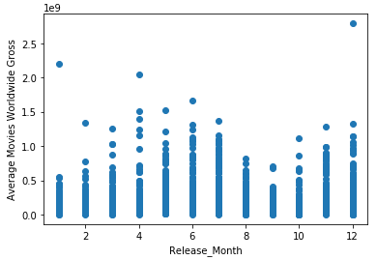
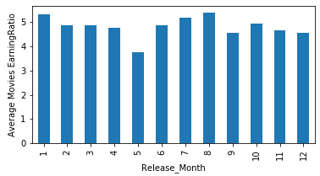
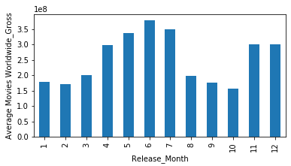
Exploratory data analysis
(A)
Q1: “Which year was the best for movie production?”
Bonus insight: Which month is the most profitable?
Plots Explanation & Insights:
A: Most of the movies are released at: July, August, December.
The least were released at April, September.
B: The highest Earning Ratio (Budget : Gross) is at: January, July, August.
C: The highest worldwide gross average of movies is at: May, June, July
Conclusion: By the results above we can conclude that July is the most profitable release month for movies.
(B)
(C)
(B)
(C)

Slide 28

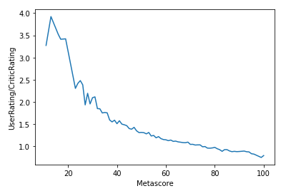
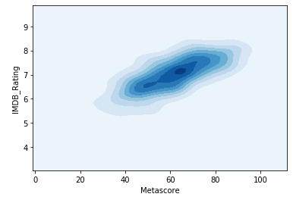
Exploratory data analysis
Q2: “Do user ratings similar to critics ratings?”
For this question we need to define 2 types of ratings:
IMDB_Rating: User’s ratings (Scale: 1-10)
Metascore: Ratings from Metacritic.com , Created by the world’s most respected critics (Scale: 1-100)
By those 2 values, we can calculate a new value:
RatingDiff = IMDB_Rating * 10 / Metascore
RatingDiff = 1 means user rate the same as the critics
RatingDiff > 1 means users rate movies higher than critics
RatingDiff < 1 means critics rate movies higher than users
By the first plot we can conclude:
For Movies rated around 75/100 the critics’ and user’s rating are similar.
When it comes to low rated movies (rating < 70), users tend to give a much better rating.
When it comes to high rated movies (rating > 80), users tend to give a lower rating.
The second plot shows that user’s rating centers around 7.2 and more narrowed, while critics’ rating centers around 63 but much varied.

Slide 29
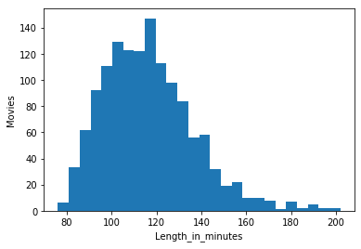
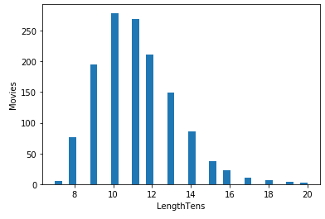
Exploratory data analysis
Q3: “How long should a successful movie be?”
Like the first question, we need to define the meaning of “successful movie”:
As we see it, there are 2 measuring aspects for movies’ success: Rating aspect and Economic aspect.
In order to answer this question, a new column has been created: “LengthTens”, which is simply the movie length divided by 10 – This is used to present constant sequence differences.

Slide 30
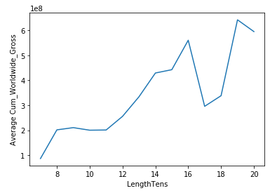
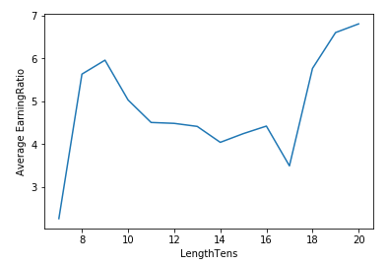
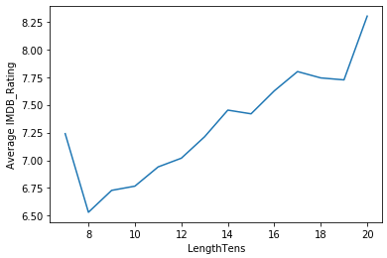

Exploratory data analysis
Q3: “How long should a successful movie be?”
(A)
(B)
Plot A: Worldwide gross against MovieLength: The movies which earned the most money are (160min) or (190min) long.
Plot B: EarningRatio (Gross/Budget) against MovieLength: The movies which earned the most money compared to their budget was actually (90min) or (180min+) long
Plot C/D: Movies ratings against MovieLength: The highest rated movie’s are actually the shortest (70min-) or the longest (180min+)
Conclusion: If production company wants their movie to be both profitable and high rated (successful), it is the best to aim for a long movie (180min+).
Otherwise, if only profit is the goal – it is the best to aim for a 90min movie – which will give them x6 earnings compared to their budget, but an average rating score between 50-65.
(C)
(D)

Slide 31



Exploratory data analysis
Q4: “Which genres people rate higher?”
Usually, movies can be categorized into genres – such as Drama, Action, Comedy, Adventure, etc.
Often (94.3%) a movie will be categorized into more than one genre: A main genre and secondary genre.
In order to answer our question, we will have to understand the relationship between the genres, and the ratings of the movies.

Slide 32

Exploratory data analysis
Q4: “Which genres people rate higher?”
The following graph represents the user’s Rating range of each Main Genre.
Examination of the different genres medians,
Shows the following ranking:
1. Biography: 7.6
2. Drama: 7.5
3. Crime: 7.5
4. Animation: 7.4
At the bottom we can see: “Fantasy” and “Horror” with a median of (6.6) only

Slide 33

Exploratory data analysis
Q4: “Which genres people rate higher?”
The following graph represents the user’s Rating range of each Secondary Genre.
Examination of the different genres medians,
Shows the following ranking:
1. War: 7.8
2. History: 7.6
3. Action: 7.5
At the bottom we can see:
1. “Musical” 6.5
2. “Horror”/”Fantasy”/”Sci-Fi” 6.7

Slide 34

Exploratory data analysis
Q4: “Which genres people rate higher?”
The following plot represents the average rating of each Genres combination.
The highest rated combination are:
1. (Drama, Western) 8.3
2. (Drama, War) 8.0
3. (Animation, Family) 7.8
The lowest rated combinations are:
1. (Comedy, Mystery) 5.5
2. (Comedy, Family) 6.1
3. (Comedy, Sci-Fi) 6.2

Slide 35

Exploratory data analysis
Q4: “Which genres people rate higher?”
Bonus insight: Which genres are the most profitable?
The following plot represents the average earning ratio (Gross/Budget) of each Genres combination.
We can see the genres with the highest profit are:
(Genres) (Gross : Budget)
1. (Horror, Mystery) x23
2. (Crime, Horror) x16
3. (Animation, Family) x12
And the lowest:
(Genres) (Gross : Budget)
1. (Action, Romance) x1
2. (Crime, Romance) x1
3. (Comedy, Sci-Fi) x1.5

Slide 36

Exploratory data analysis
Q4: “Which genres people rate higher?”
Conclusion: (at the right – Genre Budget Plot)
Biography, Action, Drama and Animation movies got the highest rating.
Action and Animation movies have much higher budget than Biography and Drama.
Horror movies are very profitable despite their low rating and Budget.
By the secondary genre ratings, we can assume people tend to rate “realistic” movies higher. (War and History vs Fantasy and Sci-Fi)

Slide 37

Predicative & Learning Experiments
In this part we will cover the Predicative & Learning experiments used to answer our question:
“ What are the most important attributes to predict gross income? ”
In order to understand the importance of the different attributes, we used “Scikit” library to create predicting models and measured their performance – Which gave us insight about their ability to learn from specific columns (attributes).
The chosen models are:
- Linear Regression
- Random Forest Classifier
- SVM Classifier
- Neural Network
- K-Means Clustering (Will be discussed later)

Slide 38
ML Experiment:
Linear Regression
* The Jupiter notebook relevant for this part is: ML-Linear Regression.ipynb
Experimental setup:
- Source dataframe: ManyRatings_Dataset_Cleaned.csv // (1990 - 2020 Most rated movies)
- Categorial variables were encoded using LabelEnconder
- Correlation Matrix of our data (Next Slide)
The Experiment:
In order to understand “What are the most important attributes to predict gross income?”, we ran the Linear Regression model with different attributes as input – than we measured the model’s r-squared score as a measurement for the model’s prediction success.

Slide 39

ML Experiment:
Linear Regression
The correlation matrix helps us decide which attributes to consider using in our model.
Green Circle = Scalar Variables
Red Circle = Categorial Variables
By this matrix we can see a correlation between Worldwide Gross and:
USA Gross (Trivial – Won’t be included)
Budget (0.71)
Reviewer’s Amount (0.47)
Release Year (0.33)
Genre (-0.29)
Length (0.27)
Results: The best results for Linear Regression were achieved using the above attributes and gave us a score of: R-squared = 0.733

Slide 40

ML Experiment:
- Random Forest Classifier
- SVM Classifier
- Neural Network
* The Jupiter notebook relevant for this part is: ML-World_Gross.ipynb
Experimental setup:
Source dataframe: ManyRatings_Dataset_Cleaned.csv // (1990 - 2020 Most rated movies)
Categorial variables were encoded using LabelEnconder
Scalar Variables were standardized using SKLearn StandardScaler.
The Experiment:
This time we use Classifier models in order to predict the Worldwide Gross Income of movies, which requires us to transform the predicted value from Scalar to Categorial variable.
We divided the “Worldwide Gross” column into 3 Categories (Plot A):
Low Gross: 0$ - 200M$
Medium Gross: 200M$ - 400M$
High Gross: 400M$ - inf
(A)

Slide 41




ML Experiment:
- Random Forest Classifier
- SVM Classifier
- Neural Network
Results:
Using the same attributes we used for the Linear Regression model:
We achieved the following results:

Slide 42
ML Experiment:
- Random Forest Classifier
- SVM Classifier
- Neural Network
Analysis:
Accuracy Score of 0.767 can be compared to other model’s score which uses different sets of attributes to relay on.
Comment | Neural Network Score | SVM Classifier Score | Random Forest Classifier Score | Input Attributes
Most correlated by correlation matrix | 0.767 | 0.749 | 0.763 | 'Budget', 'Reviewer_count', 'Release_Year', 'Genre_1', 'Length_in_minutes'
Analysis based on ratings | 0.571 | 0.571 | 0.509 | ‘'Metascore','IMDB_Rating'
Analysis based on categorial attributes | 0.594 | 0.590 | 0.653 | 'Genre_1','Director','Writer_1','Star_1','Star_2','Production_Company', 'Censor_Board_Rating'
Analysis based on information available at release | 0.671 | 0.660 | 0.719 | 'Budget', 'Release_Year', 'Release_Month', 'Genre_1', 'Genre_2', 'Length_in_minutes'
Most correlated by correlation matrix + IMDB_Rating | 0.741 | 0.741 | 0.756 | 'Budget', 'Reviewer_count', 'Release_Year', 'Genre_1', 'Genre_2', 'Length_in_minutes','IMDB_Rating'

Slide 43
ML Experiment:
- Random Forest Classifier
- SVM Classifier
- Neural Network
Insights:
The best accuracy score achieved by this dataset stands for 0.767 which is decent
Budget is the most important factor for predicting the gross income
User’s and Critics’ ratings were unrelated to predicting gross income
The Genres of the movie are correlated to the worldwide gross as well
Release year is “Predictive” due to the growth of the movie industry over time.
Conclusion:
The important attributes to predict gross income are:
Before the release:
Budget
Genres
Movie Length
Release Year
Release Month
After the release:
Budget
Genres
Movie Length
Release Year
Review Count

Slide 44

ML Experiment:
K-Means Clustering
* The Jupiter notebook relevant for this part is: ML-Clustering.ipynb
Experimental setup:
- Source dataframe: 250_Dataset_Cleaned.csv // (Top 250 IMDB Movies)
- Categorial variables were encoded using LabelEnconder
- PCA was used to reduce our dataset’ dimensions (2D)
The Experiment:
We used K-Means Clustering model in order to analyze and evaluate the Natural clusters exist in the TOP 250 dataset.
For presentation purposes, we will focus on the Top 100 movies of that list.

Slide 45

ML Experiment:
K-Means Clustering
Input: Genres, Star, Director, Release Year, Censor Board Rating, Budget, Length, Gross, Production Company
Result: 2D Clustering distribution:
The following groups were achieved using 4 initiative states:
Groups Description:
Group 1:
Mostly Drama/Crime movies
Group 2:
Mostly war movies
Group 3:
Star Wars / Lord of the rings franchise
Group 4:
Avengers franchise
Groups Analysis
Group 1:
Contains mostly old movies (dense distribution)
Group 2:
All with USA Gross range of 290M$-460M$
Group 3:
All with USA Gross range of 130M$-250M$
Group 4:
Has the same Director, Star, Genre – USA Gross of more than 670M$!

Slide 46

Conclusion
Summary:
In this project, we analyzed the data of IMDB.
Acquiring of the data was possible using the BeautifulSoup Library.
Cleaning the data was a major task which included processing of strings, reformatting numerical cells, detecting outliers and treating missing values.
After the dataset got cleaned and ready, studying it was an exciting task – which revealed many useful insights using different plots, ML models, and correlation matrix.
Farther Research:
Several farther research projects could be made on this topic:
Text analyzing of the movies’ “Story Summary”, and “Plot Keywords” which included in our acquired data – What are movies made about?
Crawling of famous movie stars Facebook page, and examining the common attributes for their success.
Text analyzing of users reviews and critics, using those to understand what people find good in movies and what ruins their experience.

Slide 47
Conclusion – Questions Summary
To sum up our project, those are the primarily questions we examined and their answers summary:
What are the most important attributes to predict gross income? Budget and Genre, accuracy score of 0.767 can be achieved using those attributes with Movie Length, Release year, Reviewer count.
Which year was the best for movie production? The year 2010 was the best (with an average profit ratio [gross/budget] of 6), The year 1998 was the worst (profit ratio of 3)
Do user ratings similar to critics ratings? User’s rating centers around 7.2/10 and more narrowed, while critics’ rating centers around 63/100 but much varied.
How long should a successful movie be? For both profit and rating: 3 hours, For profit only: 90 minutes.
Which genres people rate higher? Biography, Action, Drama and Animation are the highest rated. Horror, Fantasy and Musical are the lowest rated.

Slide 48

THE END

